Slide 1

Web Scraping To Gain Company Insights
Jagan Saravana
11/08/2024

Slide 2
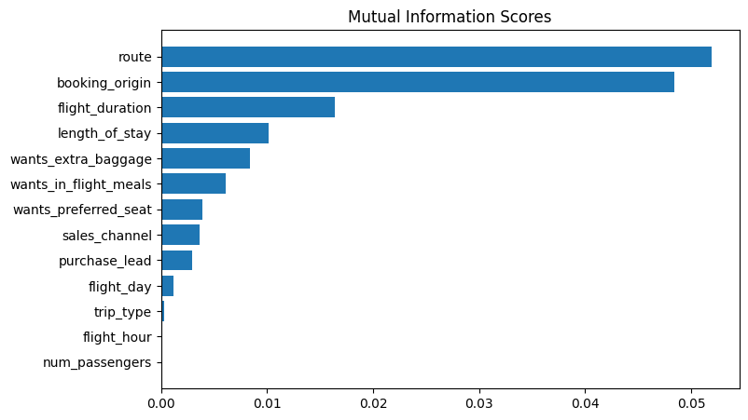
Predictive Model To Understand Factors That Influence Buying Behaviour
We have trained the data set with Random Forest Classifier Model and Received
ACCURACY : 84.98
AUC Score : 0.5424
1. route
2. Booking origin
3. Flight duration
4. Wants extra baggage
5. Length of stay
Are the top 5 features which influence Customer
Buying Behaviour
We need to increase the AUC Score.

